Slide 1
Recall: what measures what can be produced (output) from a given amount of input?

Slide 2
Recall: what measures what can be produced (output) from a given amount of input?
PRODUCTIVITY

Slide 3
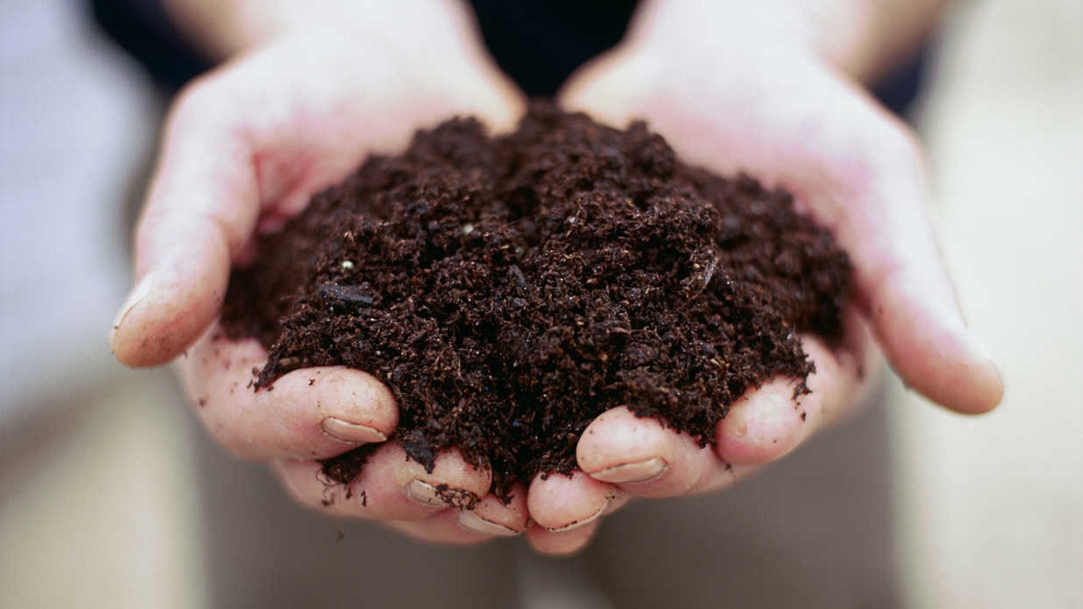
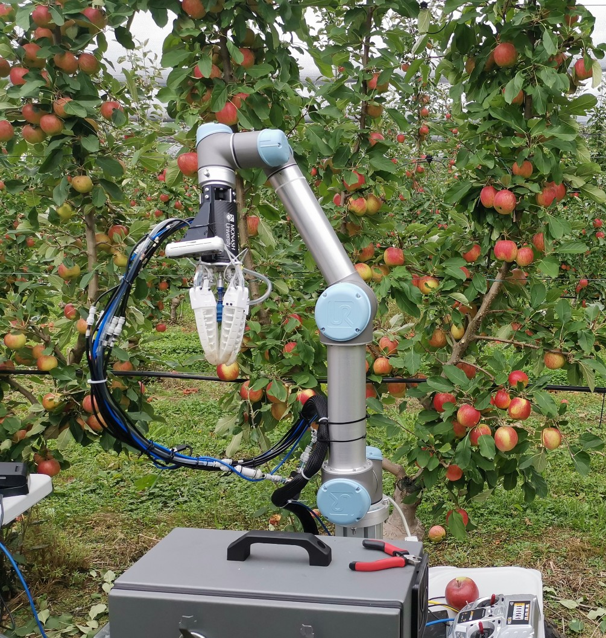


Slide 4
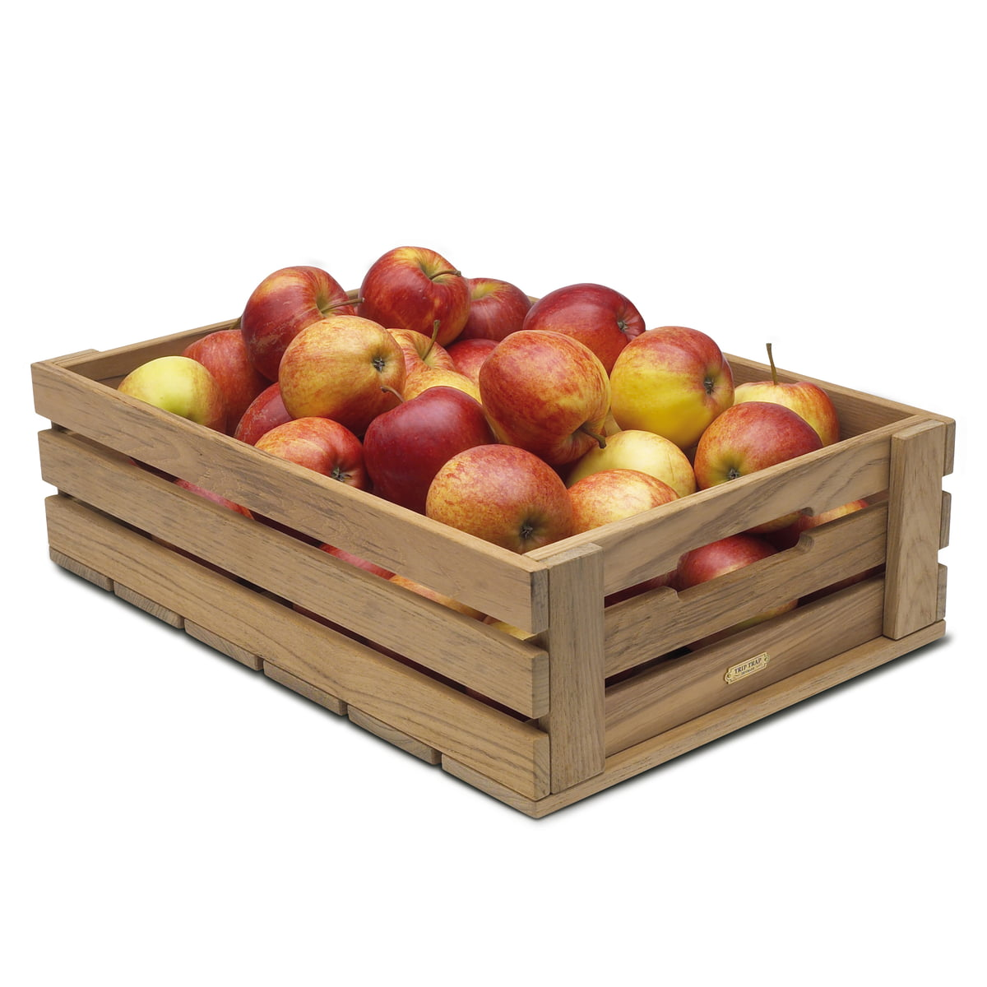

Slide 5
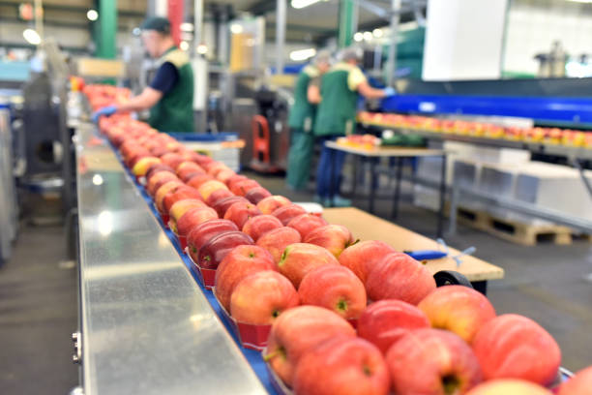
Use fewer of these resources (inputs)
To produce
Labour
The same quantity
Capital
OR
Natural Resources
Greater quantity

Slide 6
A business can increase its productivity by using its labour and capital resources more effectively and improving its business processes

Slide 7
Read about Labour and Capital Productivity

Slide 8
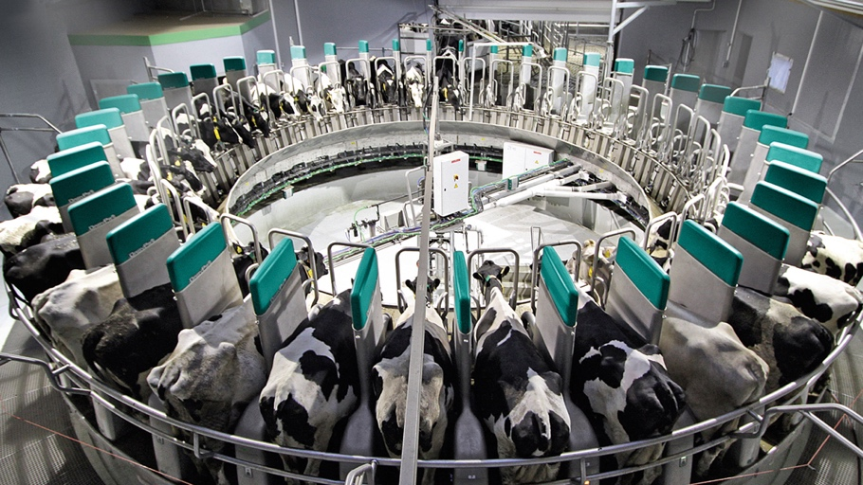
https://www.youtube.com/watch?v=JgeVk41bTVI
The Finlayson family from Tagori, Tasmania adopted an Automatic Milking System that helped them to do their job more efficiently and increased their herd production by 10 %

Slide 9

https://www.youtube.com/watch?v=6EkxVw9TcSk

Slide 10
Complete the activities in your HASS notes

